Slide 1
Rescue Robot
Team Members
Abdullah Zafar
Mustafa Touqir
Dawar Zaman
Aizaz ali shah
Rohail Usman
Syed Muhammad Saim
Team Entropy

Slide 2
Different components of Rescue Robot
Main Body
Robot Arm
Wheels
Water Canon
Ladder
Head Lights

Slide 3
Main Body

Slide 4
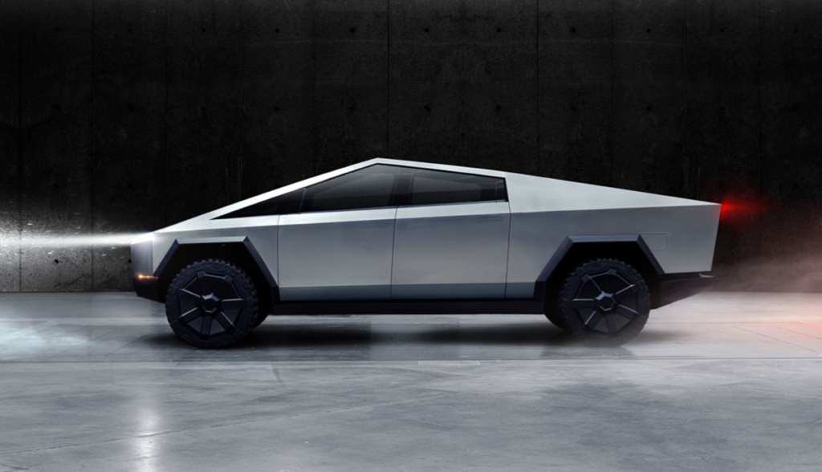
Inspired By Solid Structure of Cyber Truck

Slide 5
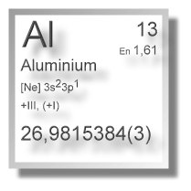
What is the Structure made of and why?
Aluminium
Aluminium is known for its light weight and strong structure.
Aluminium is one third weight of steel

Slide 6
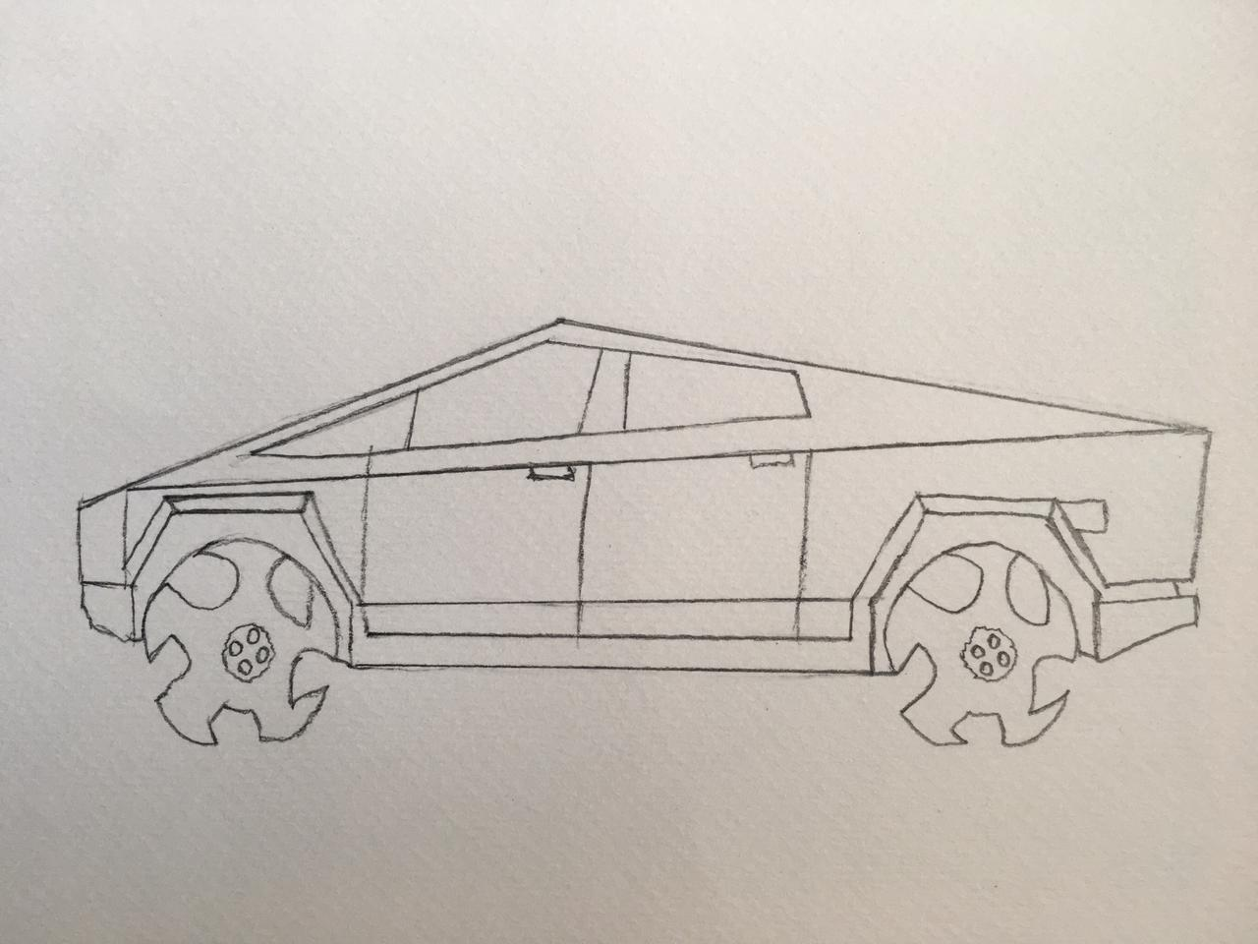

Slide 7
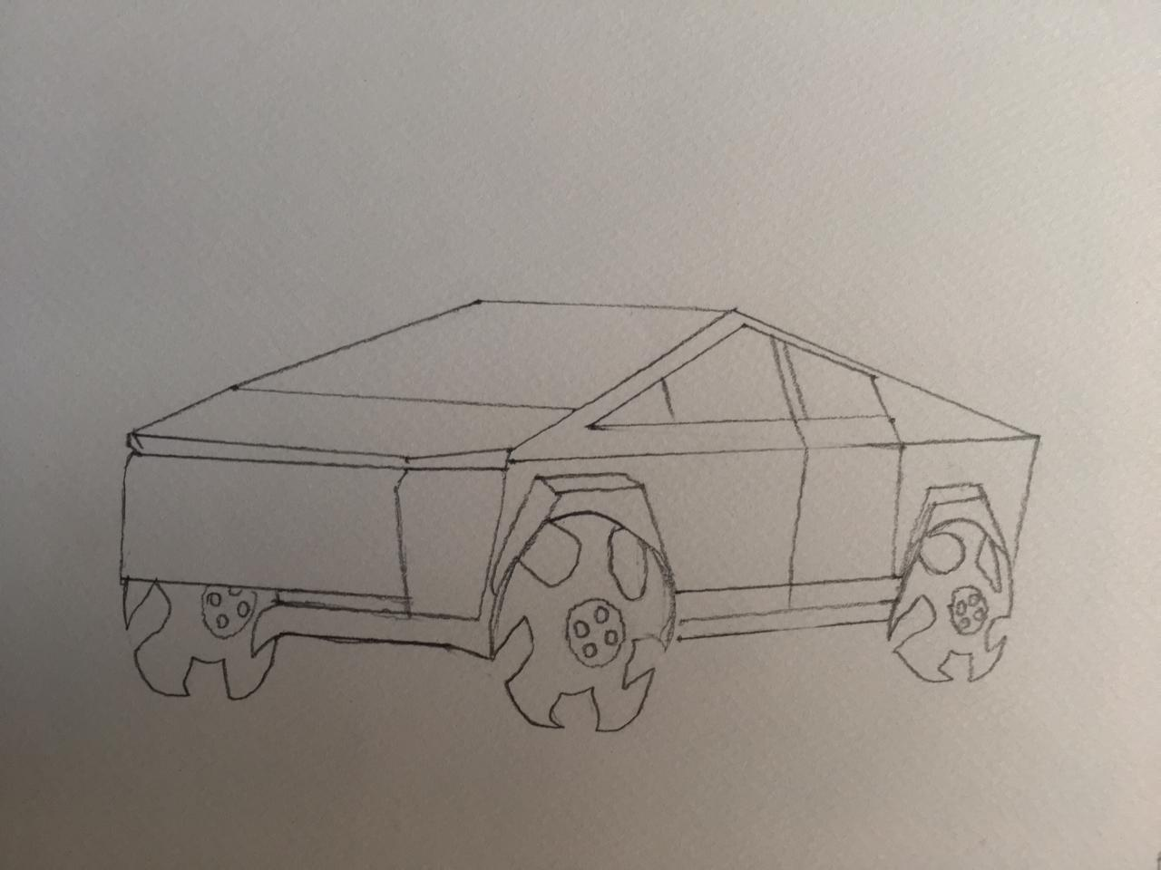

Slide 8
No Trunk included as the Cyber Truck Has!
Strong closed and compact interior.

Slide 9
Hydraulic Robot Arm

Slide 10
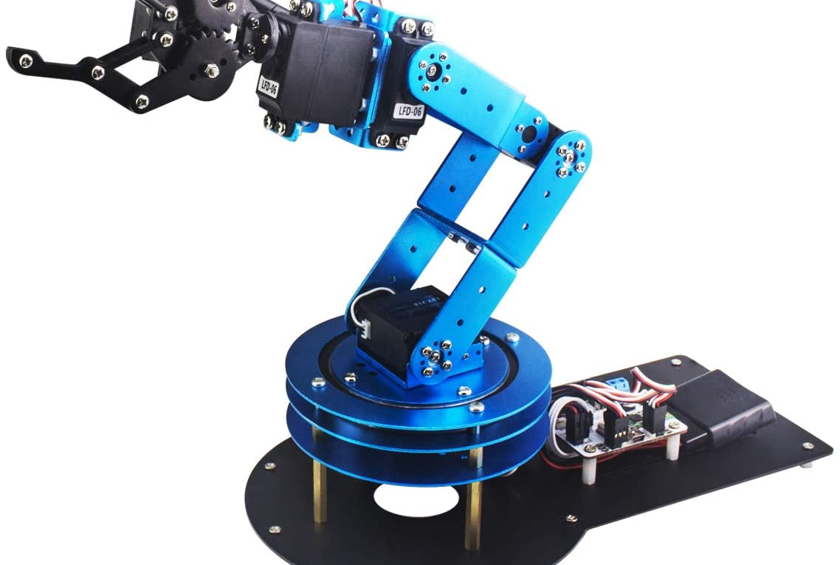
Inspiration

Slide 11
Pointy Gripper required to get hold of Debris

Slide 12
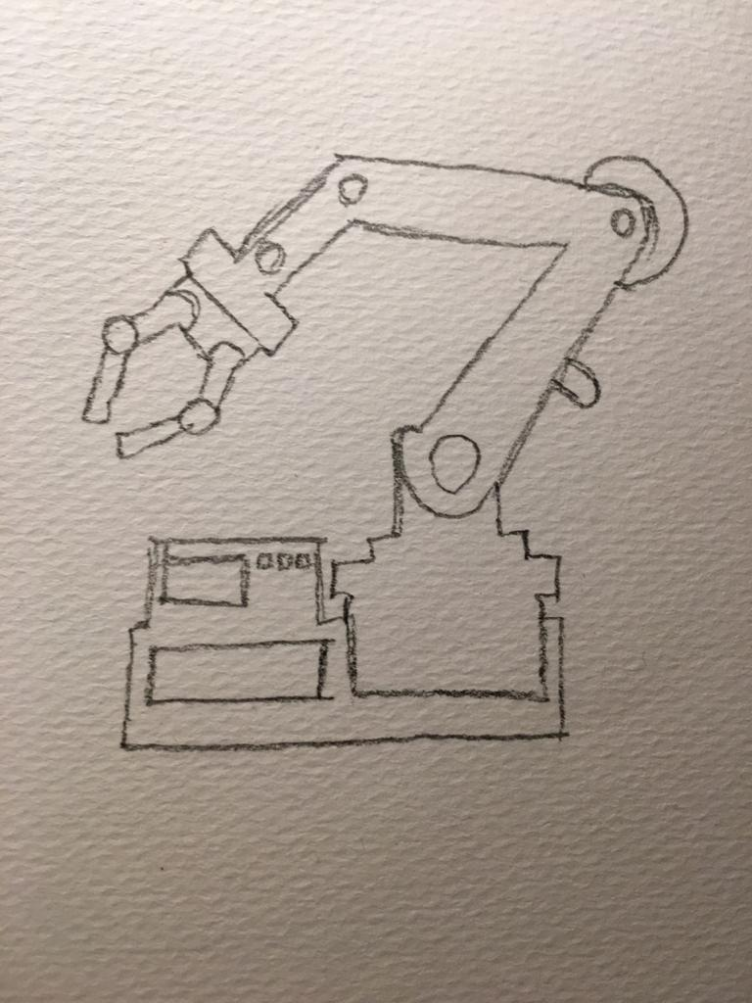

Slide 13
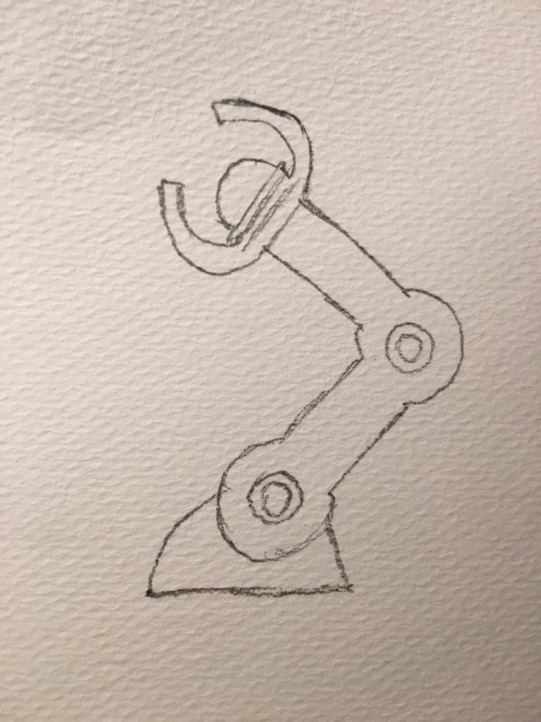

Slide 14
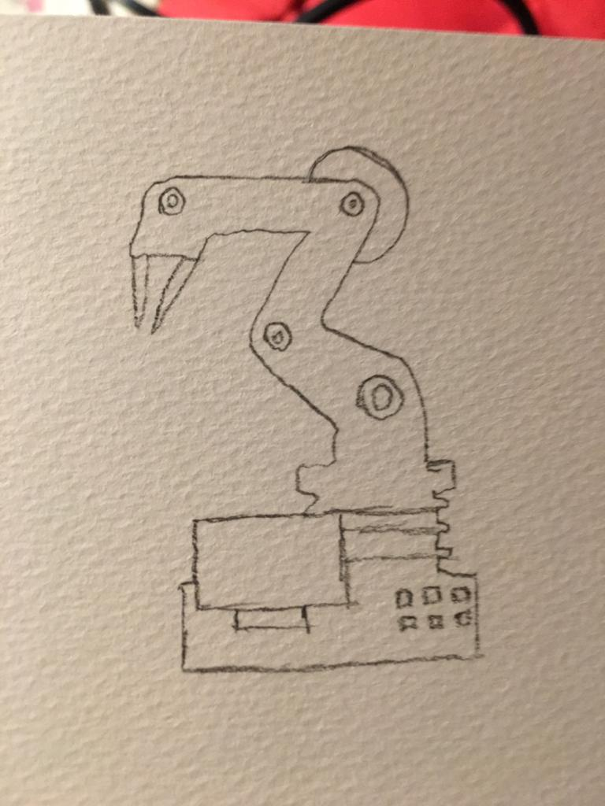

Slide 15
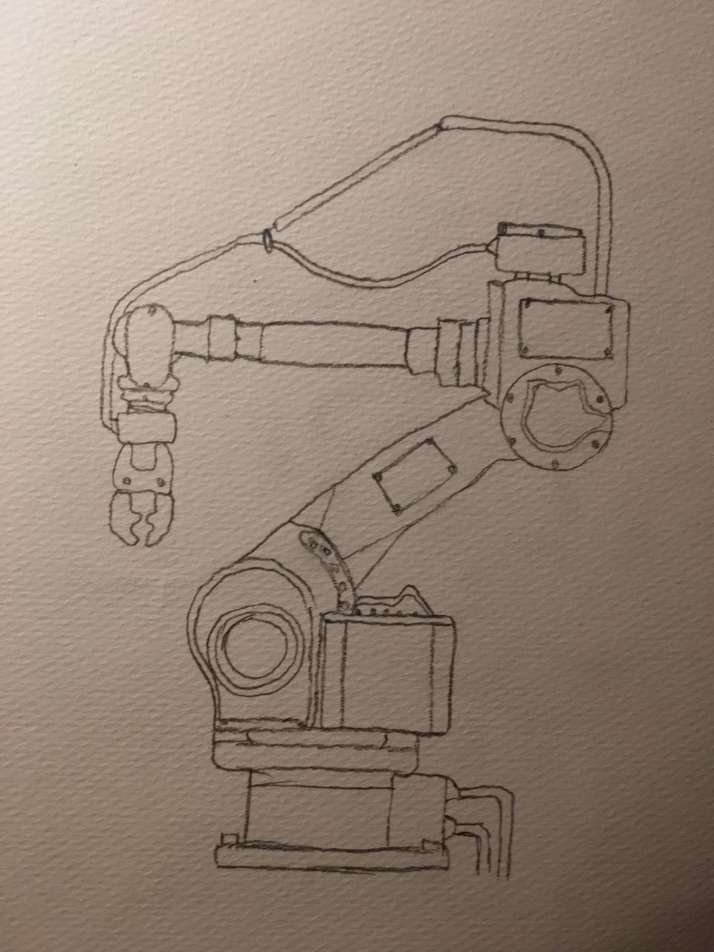

Slide 16
Wheels

Slide 17
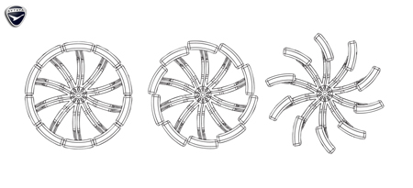
Inspiration

Slide 18
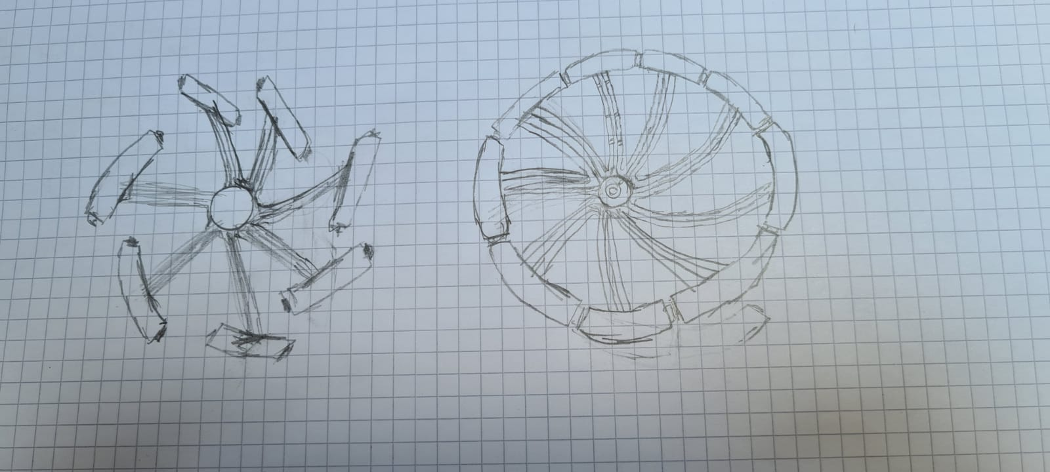

Slide 19
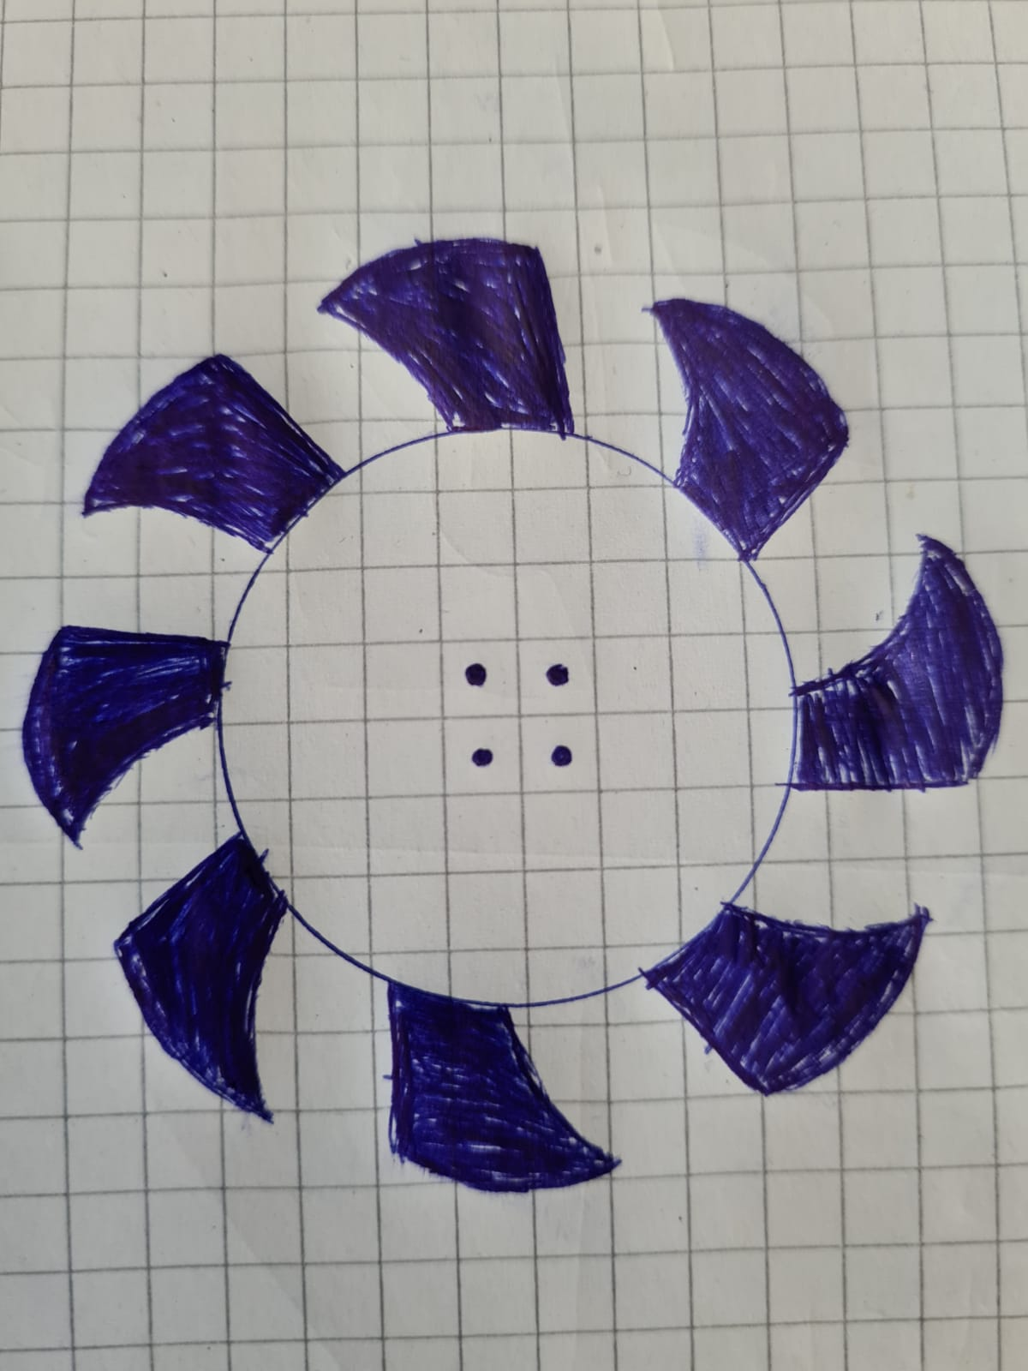

Slide 20
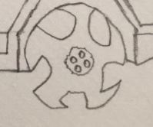

Slide 21
Water Canon

Slide 22
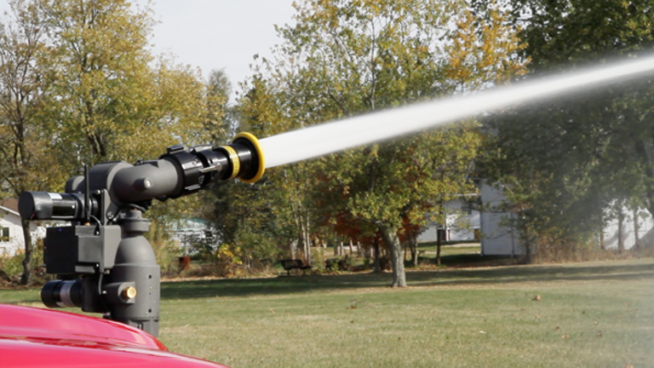
Inspiration

Slide 23
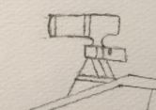

Slide 24
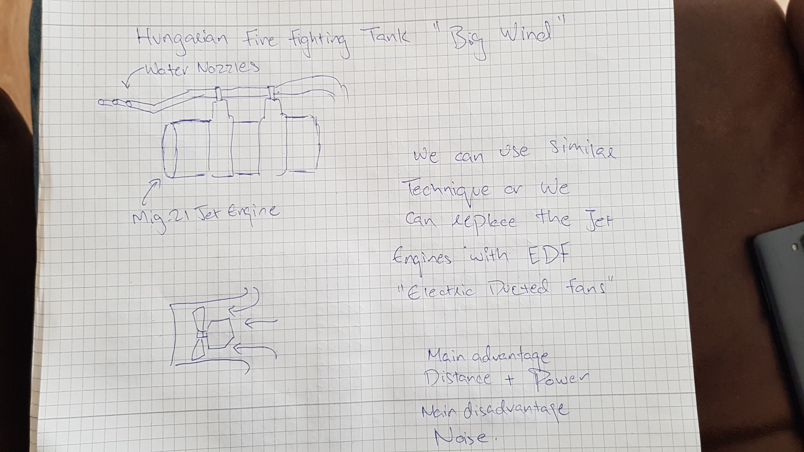
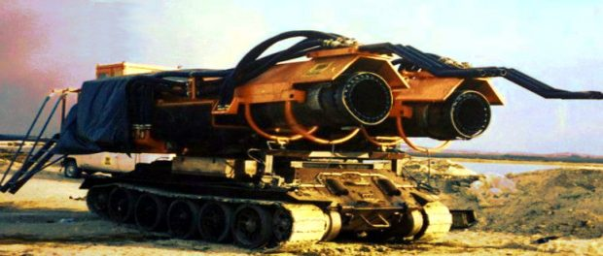
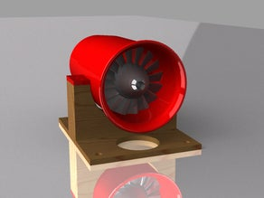

Slide 25
LADDER

Slide 26

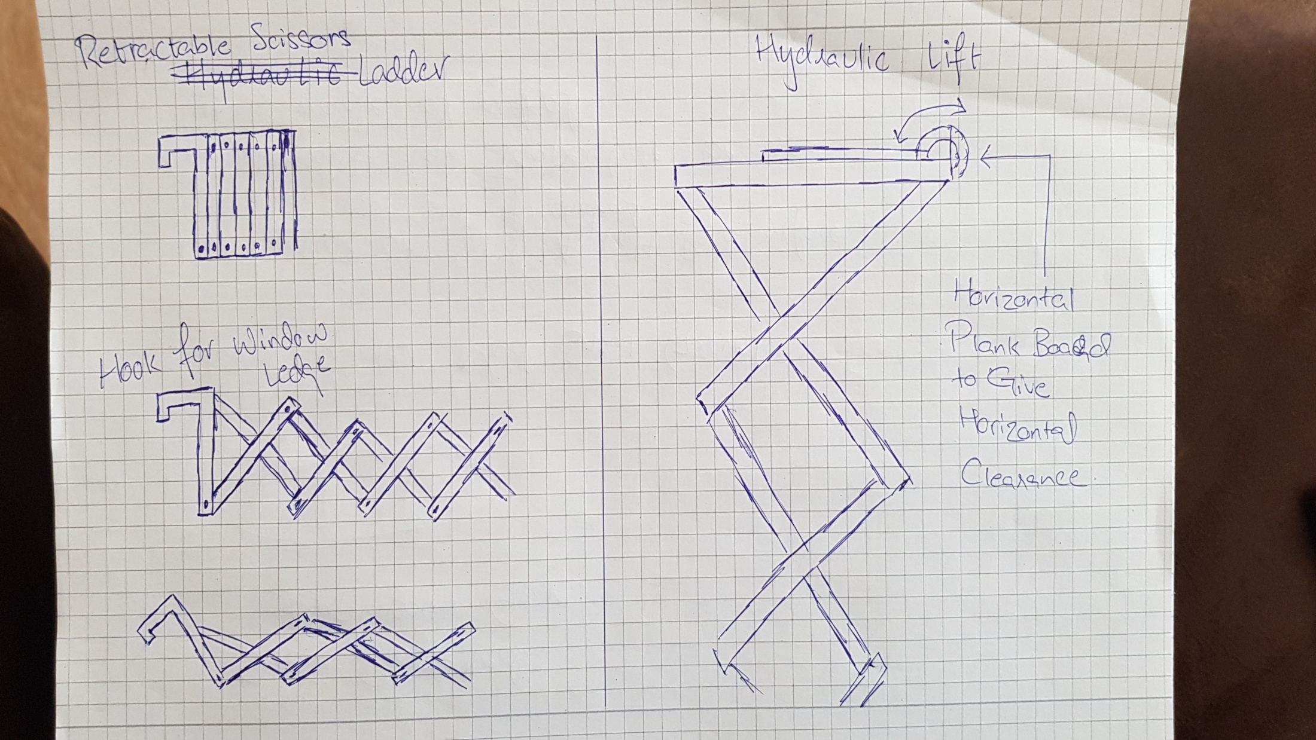
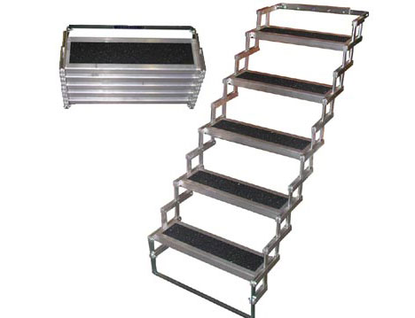
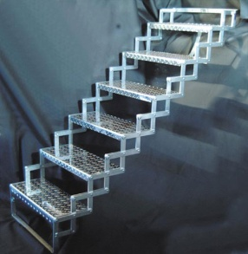
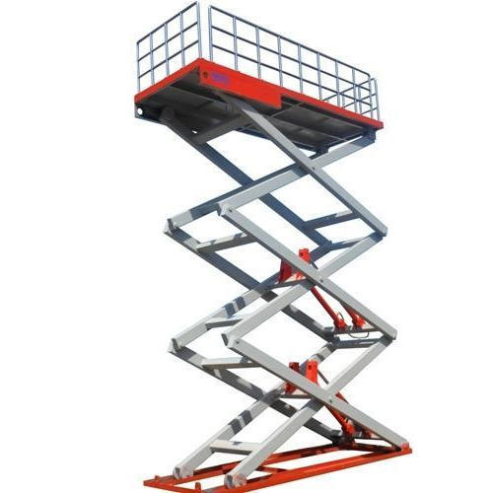

Slide 27

HEAD LIGHTS

Slide 28
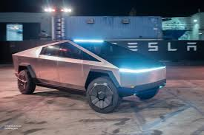
Inspiration

Slide 29
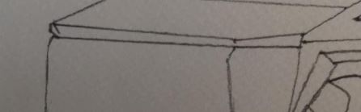

Slide 30
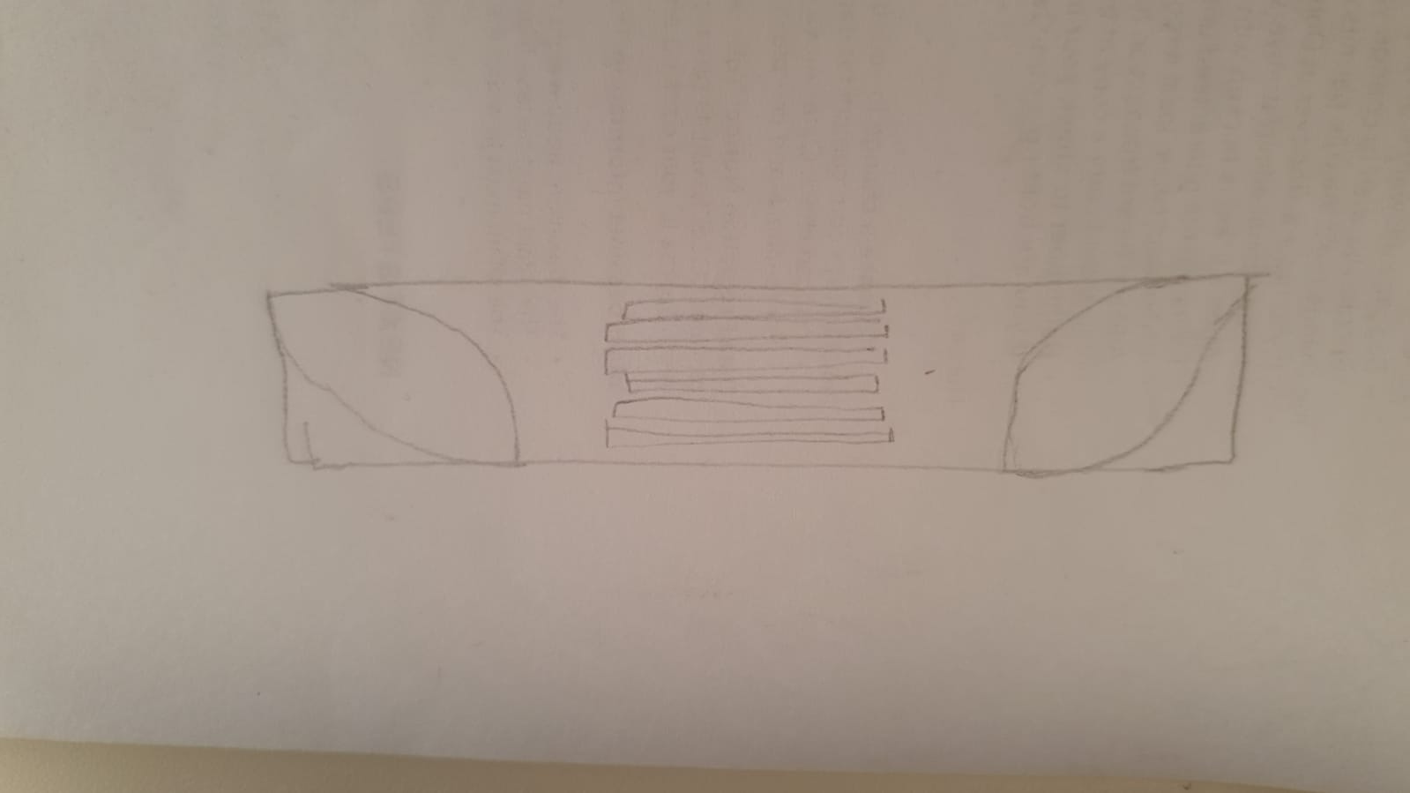

Slide 31
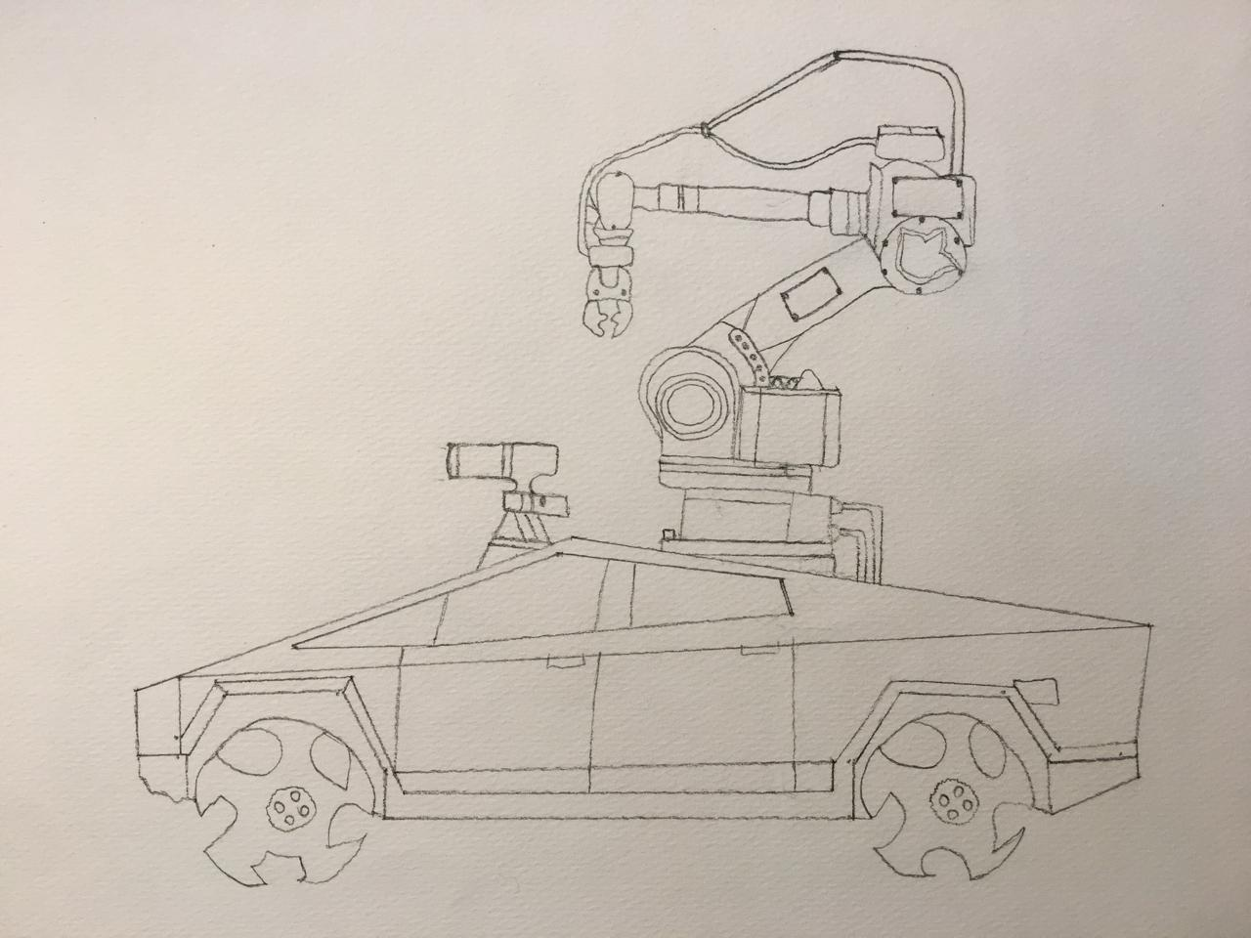
Our ultimate goal!

Slide 32
Thankyou for your time!

